Slide 1
Concept of Hashing
In CS, a hash table, or a hash map, is a data structure that associates keys (names) with values (attributes).
  Look-Up Table
  Dictionary
  Cache
  Extended Array

Slide 2
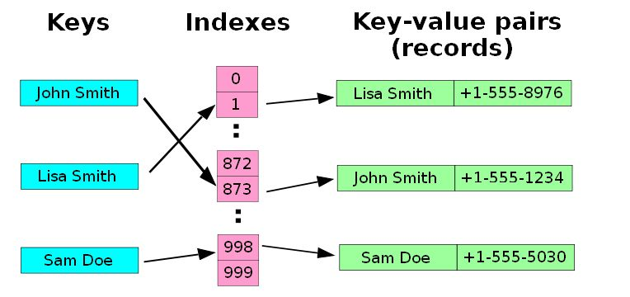
Example
A small phone book as a hash table.
(Figure is from Wikipedia)

Slide 3
Dictionaries
Collection of pairs.
  (key, value)
  Each pair has a unique key.
Operations.
  Get(theKey)
  Delete(theKey)
  Insert(theKey, theValue)

Slide 4
Just An Idea
Hash table :
  Collection of pairs,
  Lookup function (Hash function)
Hash tables are often used to implement associative arrays,
  Worst-case time for Get, Insert, and Delete is O(size).
  Expected time is O(1).

Slide 5
Origins of the Term
The term "hash" comes by way of analogy with its standard meaning in the physical world, to "chop and mix.” D. Knuth notes that Hans Peter Luhn of IBM appears to have been the first to use the concept, in a memo dated January 1953; the term hash came into use some ten years later.

Slide 6
Search vs. Hashing
Search tree methods: key comparisons
  Time complexity: O(size) or O(log n)
Hashing methods: hash functions
  Expected time: O(1)
Types
  Static hashing
  Dynamic hashing

Slide 7
Hash table
A hash table is a data structure that is used to store keys/value pairs. It uses
a hash function to compute an index into an array in which an element will be
inserted or searched. By using a good hash function, hashing can work well.
Under reasonable assumptions, the average time required to search for an
element in a hash table is O(1).

Slide 8
Static Hashing
Key-value pairs are stored in a fixed size table called a hash table.
  A hash table is partitioned into many buckets.
  Each bucket has many slots.
  Each slot holds one record.
  A hash function f(x) transforms the identifier (key) into an address in the hash table

Slide 9
Data Structure for Hash Table
#define MAX_CHAR 10
#define TABLE_SIZE 13
typedef struct {
char key[MAX_CHAR];
/* other fields */
} element;
element hash_table[TABLE_SIZE];

Slide 10
Ideal Hashing
Uses an array table[0:b-1].
  Each position of this array is a bucket.
  A bucket can normally hold only one dictionary pair.
Uses a hash function f that converts each key k into an index in the range [0, b-1].
Every dictionary pair (key, element) is stored in its home bucket table[f[key]].

Slide 11
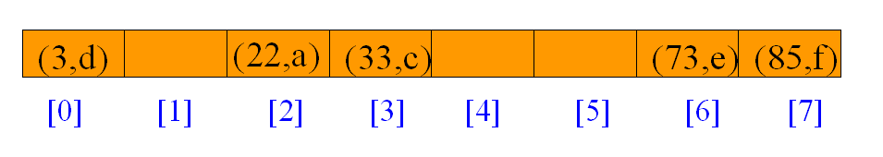
Example
Pairs are: (22,a), (33,c), (3,d), (73,e), (85,f).
Hash table is table[0:7], b = 8.
Hash function is key (mod 11).

Slide 12
What Can Go Wrong?
Where does (26,g) go?
Keys that have the same home bucket are synonyms.
  22 and 26 are synonyms with respect to the hash function that is in use.
The bucket for (26,g) is already occupied.

Slide 13
Some Issues
Choice of hash function.
  Really tricky!
  To avoid collision (two different pairs are in the same bucket.)
  Size (number of buckets) of hash table.
Overflow handling method.
  Overflow: there is no space in the bucket for the new pair.

Slide 14
Choice of Hash Function
Requirements
  easy to compute
  minimal number of collisions
If a hashing function groups key values together, this is called clustering of the keys.
A good hashing function distributes the key values uniformly throughout the range.

Slide 15
Some hash functions
Middle of square
  H(x):= return middle digits of x^2
Division
  H(x):= return x % k
Multiplicative:
  H(x):= return the first few digits of the fractional part of x*k, where k is a fraction.

Slide 16
Some hash functions II
Folding:
  Partition the identifier x into several parts, and add the parts together to obtain the hash address
  e.g. x=12320324111220; partition x into 123,203,241,112,20; then return the address 123+203+241+112+20=699
  Shift folding vs. folding at the boundaries
Digit analysis:
  If all the keys have been known in advance, then we could delete the digits of keys having the most skewed distributions, and use the rest digits as hash address.

Slide 17
Overflow Handling
An overflow occurs when the home bucket for a new pair (key, element) is full.
We may handle overflows by:
  Search the hash table in some systematic fashion for a bucket that is not full.
    Linear probing (linear open addressing).
    Quadratic probing.
    Random probing.
  Eliminate overflows by permitting each bucket to keep a list of all pairs for which it is the home bucket.
    Array linear list.
    Chain.

Slide 18
Linear probing (linear open addressing)
Open addressing ensures that all elements are stored directly into the hash table, thus it attempts to resolve collisions using various methods.
Linear Probing resolves collisions by placing the data into the next open slot in the table.

Slide 19
Linear Probing – Get And Insert
divisor = b (number of buckets) = 17.
Home bucket = key % 17.
0
4
8
12
16
34
0
45
6
23
7
28
12
29
11
30
33
Insert pairs whose keys are 6, 12, 34, 29, 28, 11, 23, 7, 0, 33, 30, 45

Slide 20
Linear Probing – Delete
0
4
8
12
16
34
0
45
6
23
7
28
12
29
11
30
33
Delete(0)
0
4
8
12
16
34
45
6
23
7
28
12
29
11
30
33
Search cluster for pair (if any) to fill vacated bucket.
0
4
8
12
16
34
45
6
23
7
28
12
29
11
30
33

Slide 21
Linear Probing – Delete(34)
0
4
8
12
16
34
0
45
6
23
7
28
12
29
11
30
33
0
4
8
12
16
0
45
6
23
7
28
12
29
11
30
33
Search cluster for pair (if any) to fill vacated bucket.
0
4
8
12
16
0
45
6
23
7
28
12
29
11
30
33
0
4
8
12
16
0
45
6
23
7
28
12
29
11
30
33

Slide 22
Linear Probing – Delete(29)
0
4
8
12
16
34
0
45
6
23
7
28
12
29
11
30
33
0
4
8
12
16
34
0
45
6
23
7
28
12
11
30
33
Search cluster for pair (if any) to fill vacated bucket.
0
4
8
12
16
34
0
45
6
23
7
28
12
11
30
33
0
4
8
12
16
34
0
45
6
23
7
28
12
11
30
33
0
4
8
12
16
34
0
6
23
7
28
12
11
30
45
33

Slide 23
Performance Of Linear Probing
0
4
8
12
16
34
0
45
6
23
7
28
12
29
11
30
33
Worst-case find/insert/erase time is Θ(n), where n is the number of pairs in the table.
This happens when all pairs are in the same cluster.

Slide 24
Linear Probing (program 8.3)
void linear_insert(element item, element ht[]){
int i, hash_value;
i = hash_value = hash(item.key);
while(strlen(ht[i].key)) {
if (!strcmp(ht[i].key, item.key)) {
fprintf(stderr, “Duplicate entry\n”); exit(1);
}
i = (i+1)%TABLE_SIZE;
if (i == hash_value) {
fprintf(stderr, “The table is full\n”); exit(1);
} }
ht[i] = item;
}

Slide 25
Problem of Linear Probing
Identifiers tend to cluster together
Adjacent cluster tend to coalesce
Increase the search time

Slide 26
Quadratic Probing
Linear probing searches buckets (H(x)+i²)%b
Quadratic probing uses a quadratic function of i as the increment
Examine buckets H(x), (H(x)+i²)%b, (H(x)-i²)%b, for 1<=i<=(b-1)/2
b is a prime number of the form 4j+3, j is an integer

Slide 27
Random Probing
Random Probing works incorporating with random numbers.
  H(x):= (H’(x) + S[i]) % b
  S[i] is a table with size b-1
  S[i] is a random permuation of integers [1,b-1].

Slide 28
Rehashing
Rehashing: Try H₁, H₂, …, H_{m} in sequence if collision occurs. Here H_{i} is a hash function.
Double hashing is one of the best methods for dealing with collisions.
  If the slot is full, then a second hash function is calculated and combined with the first hash function.
  H(k, i) = (H₁(k) + i H₂(k) ) % m

Slide 29
Data Structure for Chaining
#define MAX_CHAR 10
#define TABLE_SIZE 13
#define IS_FULL(ptr) (!(ptr))
typedef struct {
char key[MAX_CHAR];
/* other fields */
} element;
typedef struct list *list_pointer;
typedef struct list {
element item;
list_pointer link;
};
list_pointer hash_table[TABLE_SIZE];
The idea of Chaining is to combine the linked list and hash table to solve the overflow problem.

Slide 30
Separate Chaining
A hash table that uses separate chaining to resolve collisions.
The hash table is implemented as an array of linked lists.
To insert an item into the table, it is appended to one of the linked lists.
The linked list to it is appended is determined by hashing that item.

Slide 31
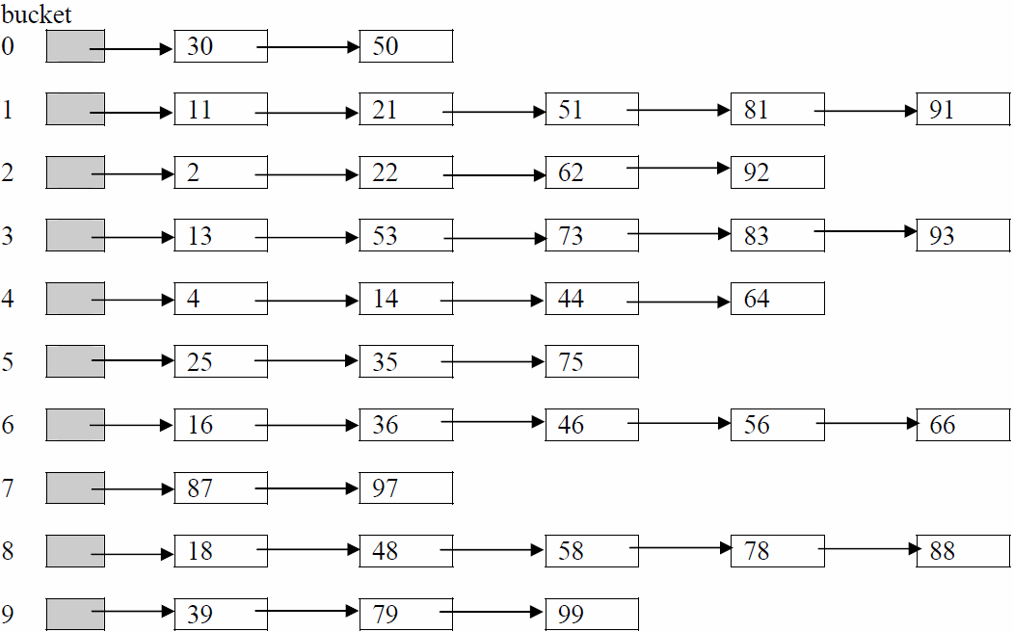
Example: insert 13, 4, 16, 87, 11, 30, 2, 18, 25, ...

Slide 32
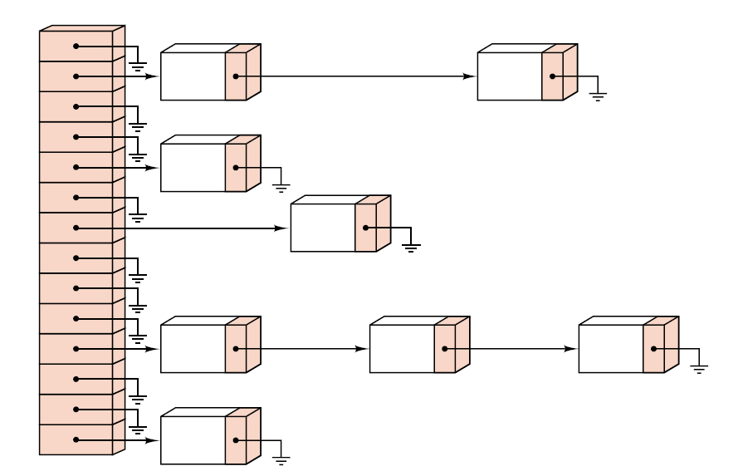
Figure of Chaining

Slide 33
Sorted Chains
[0]
0
34
[4]
Put in pairs whose keys are 6, 12, 34, 29, 28, 11, 23, 7, 0, 33, 30, 45
Bucket = key % 17.
6
23
7
[8]
11
28
45
[12]
12
29
30
[16]
33

